Slide 1

How do Managers Decide what Projects to Invest in? and Why?
Investment Decision Rules

Slide 2
outline
Decision rules for stand-alone projects
NPV, Payback, IRR, EVA
Decision rules for mutually exclusive investment opportunities
Project selection with resource constraints
Profitability index
Practice questions
Appendix (EVA with depreciation)

Slide 3
Stand-Alone Projects

Slide 4
The NPV Rule
Stand-Alone project: we decide whether to “accept” or “reject” the investment opportunity. The value of accepting the project is given by its NPV and the value of rejecting the project is zero.
When a project is selected, the change in firm value is given by the project’s NPV.
The NPV Rule
Accept all projects that have a positive NPV

Slide 5
Applying the NPV Rule
Fredrick Feed and Farm (FFF) example
FFF can produce a new environmentally friendly fertilizer at a substantial cost saving over the company’s existing line of fertilizer. The fertilizer will require a new plant that can be built immediately at a cost of $250 million. Financial managers estimate that the benefits of the new fertilizer will be $35 million per year, starting at the end of the first year and lasting forever.
What is the NPV of the project when the cost of capital is 10%?

Slide 6
Applying the NPV Rule
Fredrick Feed and Farm (FFF) example
Using the 10% cost of capital we can calculate the NPV to be $100 million
Suppose that FFF’s borrows the upfront investment of $250 million and pays interest of 10% on the loan balance every year.
Looking forward, what cash balance on this project would the CEO of FFF expect in the next 5 to 10 years?

Slide 7
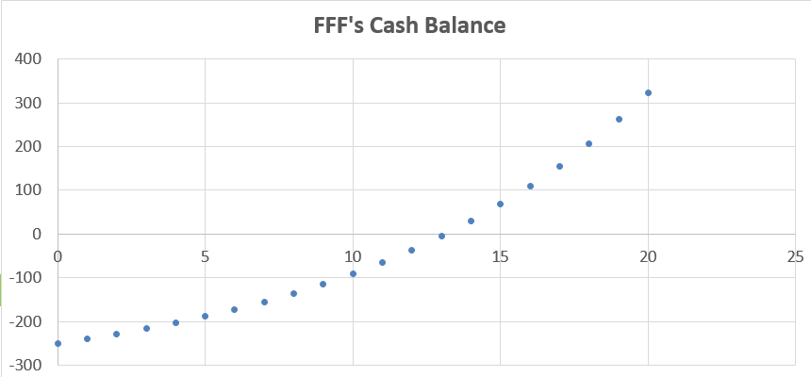
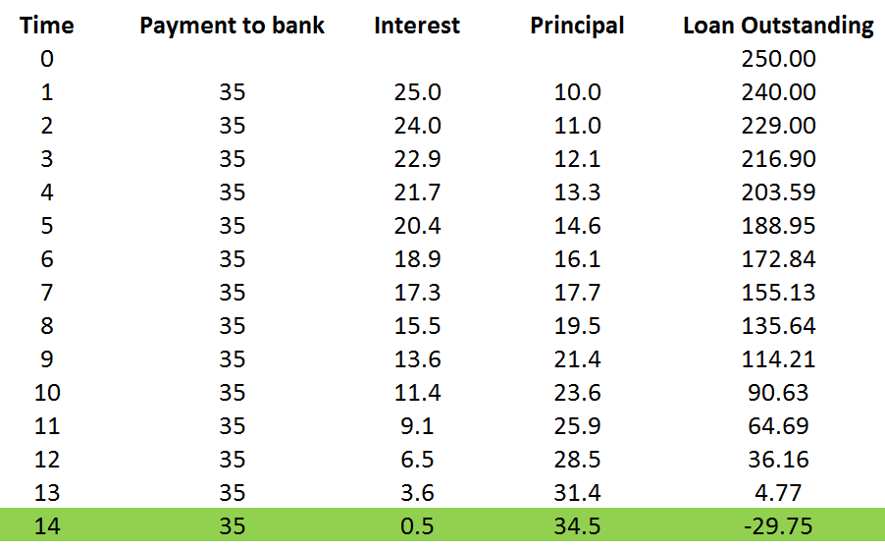
What to expect? Implementing FFF’s Project

Slide 8
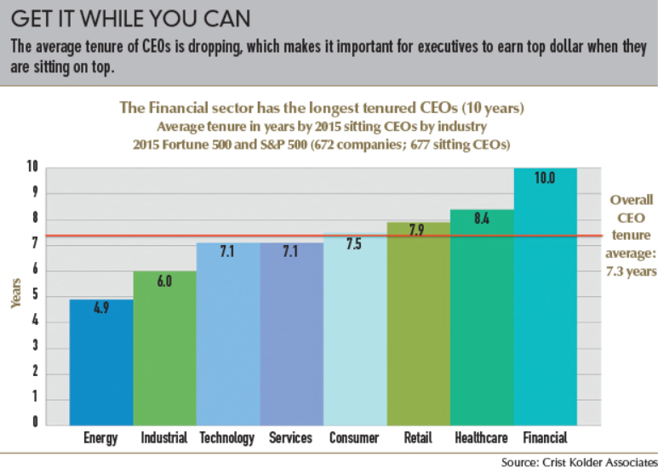
Are CEOs Keen on Long-Term Projects?

Slide 9
Alternatives to the NPV
The NPV represents the true long-term value of an investment opportunity
74.9% of the firms surveyed in Graham and Harvey (2001) use the NPV rule in making investment decisions
In practice other methods are used by firms in the capital budgeting process.
Among the common alternative methods used by firms are the Payback rule, IRR rule, and Economic Value Added or EVA.

Slide 10
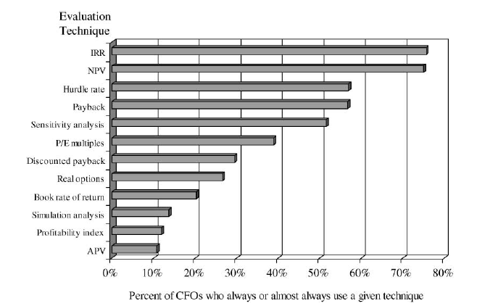
Alternatives to NPV

Slide 11
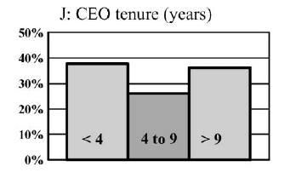
The Payback Rule
The payback investment rule: The project is accepted only if the initial investment is “recovered” or “paid back” before the payback period cutoff required by the firm.
Suppose FFF requires all projects to have a payback period of five years or less.
Five years of $35 million inflows or total of $175 million
According to a payback period of 5 years the investment should not be adopted.
Graham and Harvey (2001)

Slide 12
A Performance Target: The IRR rule
Definition:
Internal Rate of Return (IRR): The rate of return under which the NPV of a project is zero
NPV(CF’s from Project using rate “r=IRR”) = 0
What is the IRR of the project considered by FFF?

Slide 13
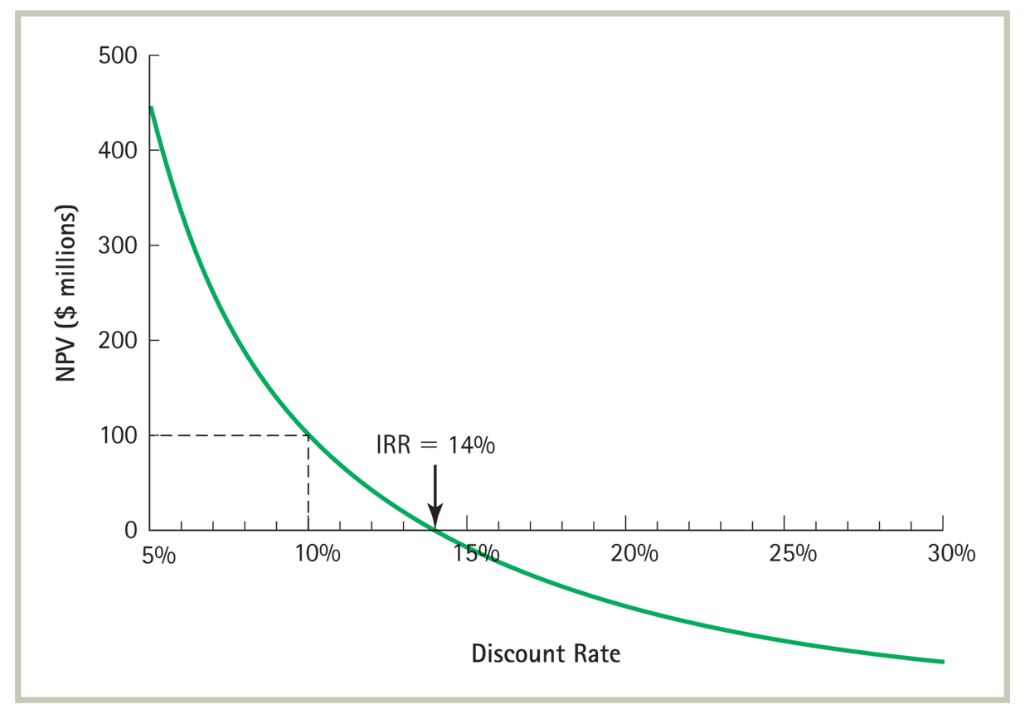
NPV of the FFF Project as a function of the Discount Rate

Slide 14
The IRR Rule
The IRR rule: accept any investment opportunity where IRR exceeds the opportunity cost of capital. Reject any opportunity whose IRR is less than the opportunity cost of capital.
What does the IRR rule imply for the FFF investment opportunity? (IRR of 14% > r of 10%)
The IRR rule will give the correct (same as NPV rule) most of the time but not all of the time!

Slide 15

Limitations of the IRR Rule
Delayed Investment example: John Star, a retired CEO, is offered a $1 million “how I did it” book deal. The publisher will pay $1 million upfront and John estimates that it will take him three years to write the book. The time he spends writing will cause him to forgo alternative sources of income amounting to $500,000 per year. John estimates his opportunity cost of capital to be 10%.
The NPV of Star’s investment opportunity:

Slide 16
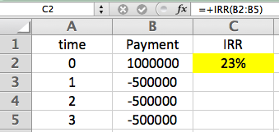
Limitations of the IRR Rule
The IRR of Star’s investment opportunity:
The IRR is higher than the cost of capital yet the project is not worth taking. For most investment opportunities expenses occur initially and cash is received later and a higher rate is better. In this case it is the opposite (like when one borrows money) – a lower rate is better

Slide 17
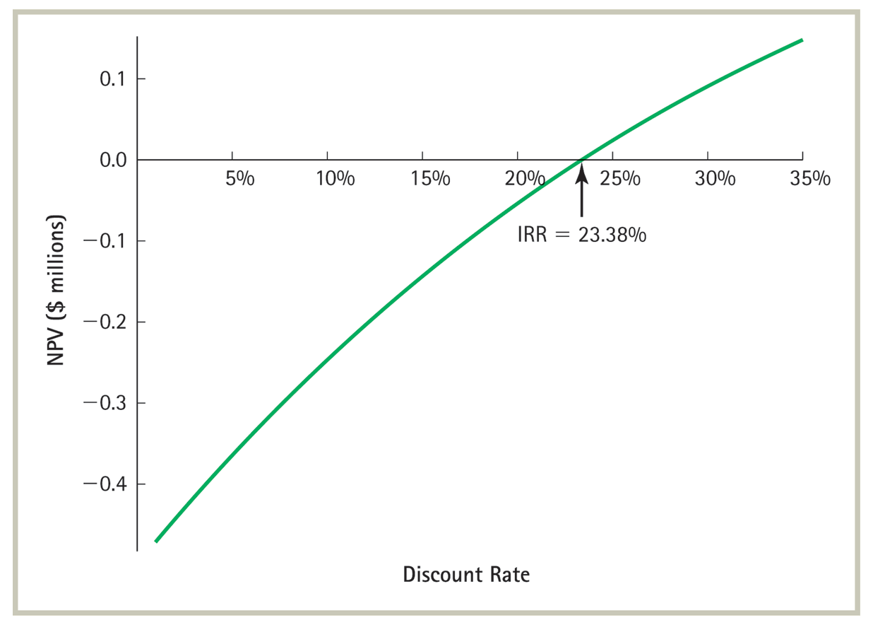
IRR and NPV for the “Delayed Investments” Example

Slide 18
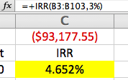
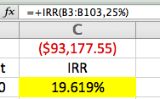
Limitations of the IRR Rule
Multiple IRRs Example: The publisher has agreed to make royalty payments of $20,000 per year forever, starting once the book is published in three years. Now, should John accept the offer?
The NPV of the modified investment opportunity:

Slide 19
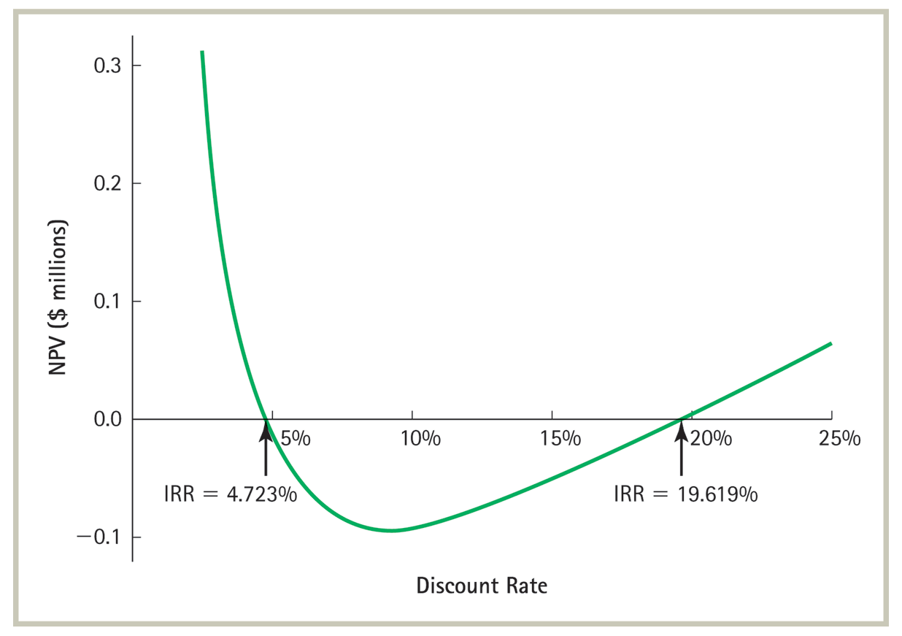
IRR and NPV for the “Multiple IRRs” Example

Slide 20
Economic Value Added
The Economic Value Added concept:
While NPV tells us whether an investment is a good idea or not at the time of investment it does not indicate performance overtime the EVA does exactly that.
Calculating EVA:
Where
.

Slide 21
The EVA Rule
The EVA Rule
Accept all projects for which the present value of EVAs is positive.
The EVA and NPV rules yield the exact same result
Example: What is the EVA of FFF's fertilizer opportunity, which required an upfront investment of $250 million, and had a benefit of $35 million each year. Is it a good investment according to the EVA rule (suppose that the capital lasts forever - zero depreciation)?

Slide 22
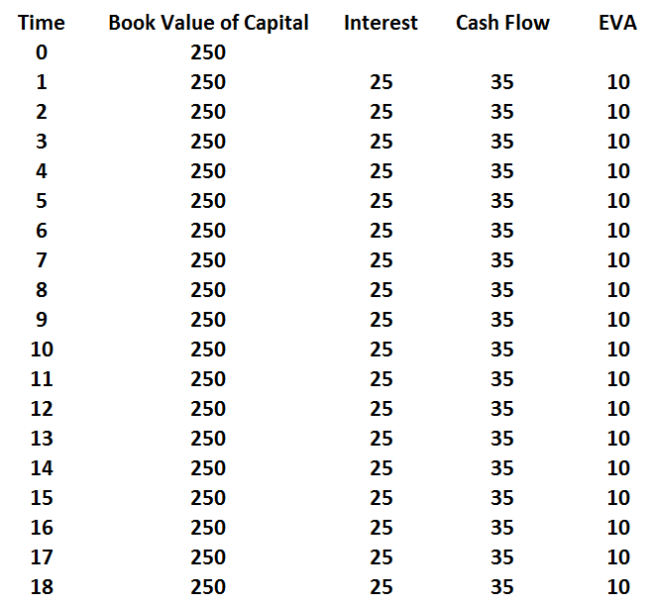
EVA for the FFF Project

Slide 23
Mutually Exclusive Investment Opportunities

Slide 24



What movie to watch tonight?
Mutually exclusive as we cannot watch both but rather must decide on one or the other.

Slide 25
Comparing Two Projects of Same Size
Don is evaluating two investment opportunities.
If he went into business with his girlfriend, he would need to invest $1000 and the business would generate incremental cash flows of $1100 per year, declining at 10% forever.
Alternatively, Don could start a single-machine Laundromat. The washer and dryer cost a total of $1000 and will generate $400 per year, declining at 20% per year forever.
The opportunity cost of capital is 12% and both will require all of Don’s time. Don must choose between the two. Which Investment opportunity should Don choose?

Slide 26
Comparing Two Projects of Same Size
Valuation of the “going into business with girlfriend” alternative:

Slide 27
Comparing Two Projects of Same Size
Valuation of the “laundromat” alternative:

Slide 28
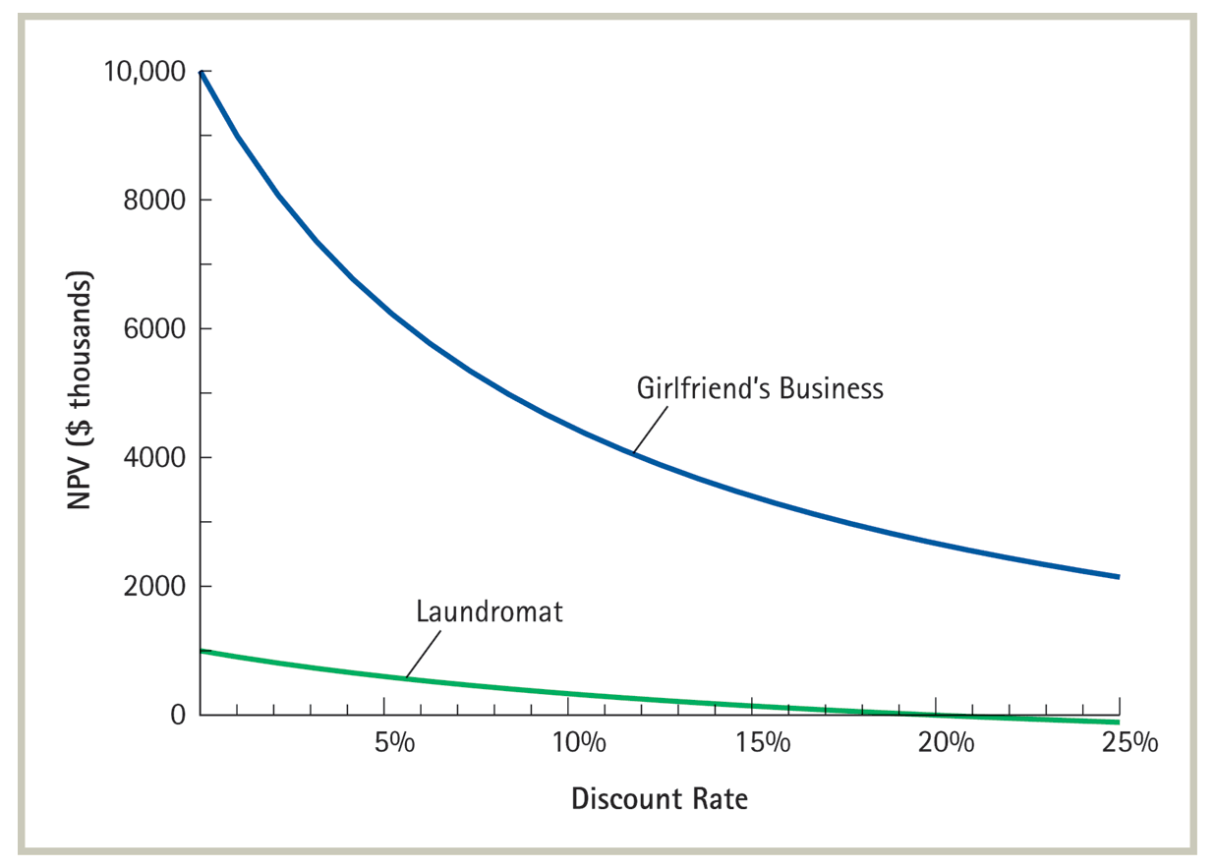
Comparing Two Projects of Same Size

Slide 29
Comparing Projects of Different Size
Don now just realizes that he can actually install 20 machines in the Laundromat. How does this change Don’s preference between the two alternatives?

Slide 30
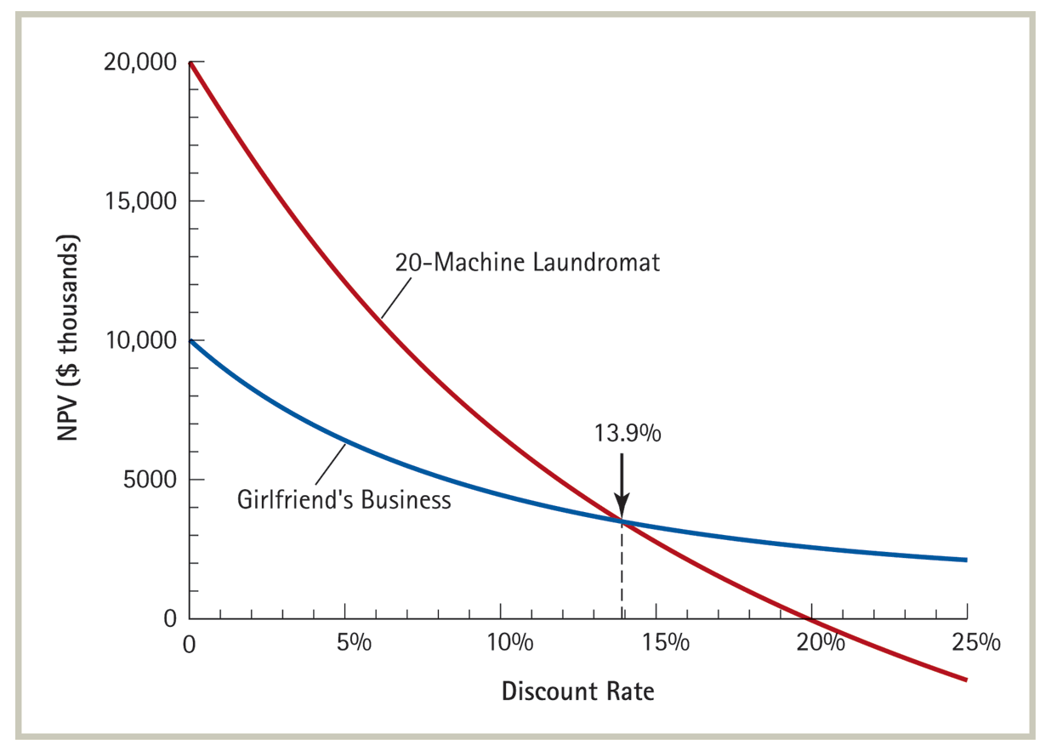
Comparing Projects of Different Size

Slide 31
Stick to the NPV Rule!
When confronted with mutually exclusive alternatives we choose the alternative that contributes the most value - the one with the highest NPV
The IRR rule is not useful when comparing mutually exclusive investment opportunities of different scale

Slide 32
Allocating Scarce Resources

Slide 33


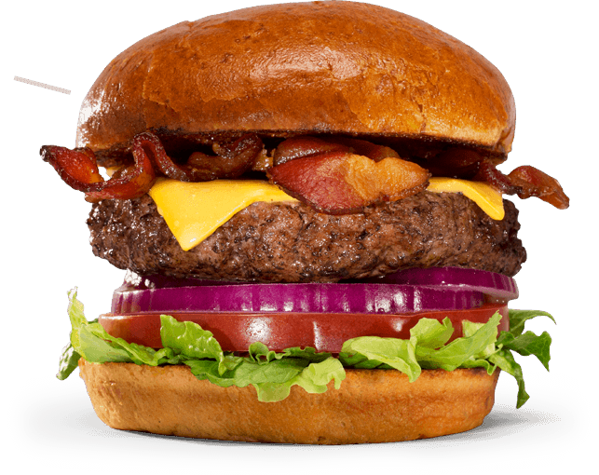


Slide 34
Prioritizing: The Profitability Index
When confronted with a resource constraint we choose the set of projects to invest in by allocating the constrained resource to the most profitable projects as ranked by their profitability index

Slide 35
Profitability Index
The profitability index of a project measures the value created (in terms of NPV) per unit of resource consumed by the project
"units" can be dollars if we are facing a capital constraint, number of employees in case of a human resource constraint, or square feet in case of a space constraint.

Slide 36
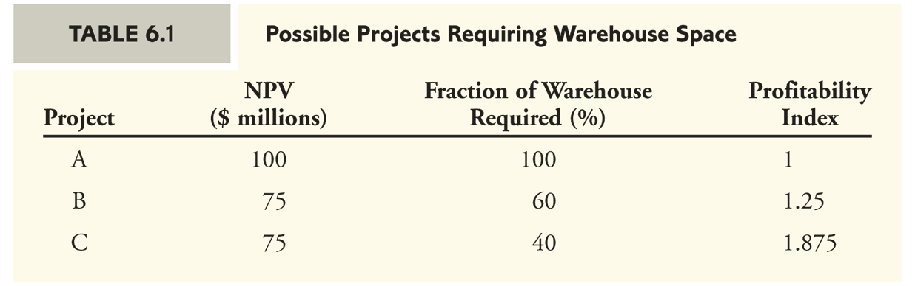
Ranking Projects by their Profitability Index
Project C is most profitable and requires 40% of warehouse space. Together with project B that requires 60% the total NPV is $150 million. This better than adopting project A to occupy 100% of warehouse space with NPV of $100 million.

Slide 37
Building a Profitability Index Table for Net-IT
Your division at Net-IT, a large networking company, has put together a project proposal to develop a new home networking router.
The expected NPV of the project is $17.7 million
It will require 50 software engineers.
Net-IT has a total of 190 engineers available, and the router project must compete with the following other projects for these engineers.
How should Net-IT prioritize these projects?

Slide 38
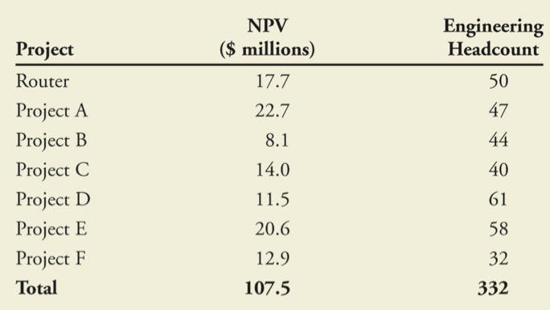
Net-IT Projects

Slide 39
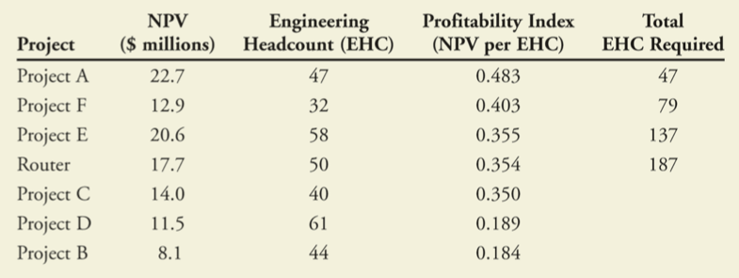
The Right Comparison
By dividing the NPV of a project by the number of engineers it requires we establish an “NPV per Engineer” Profitability Index.

Slide 40
Further examples

Slide 41
IRR and NPV for OpenSeas
Question 7 (2nd edition)
OpenSeas, Inc. is evaluating the purchase of the new cruise ship. The ship would cost $500 million, and would operate for 20 years. OpenSeas expects annual cash flows from operating the ship to be $70 million (at the end of each year) and its cost of capital is 12%.
Prepare an NPV profile of the purchase.
Estimate the IRR (to the nearest 1%) from the graph.
Is the purchase attractive based on these estimates?
How far off could OpenSeas’ cost of capital be (to the nearest 1%) before your purchase decision would change?

Slide 42
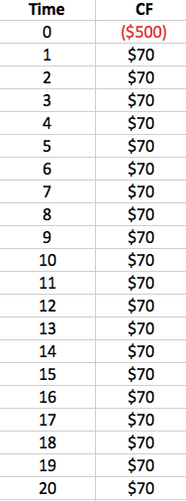
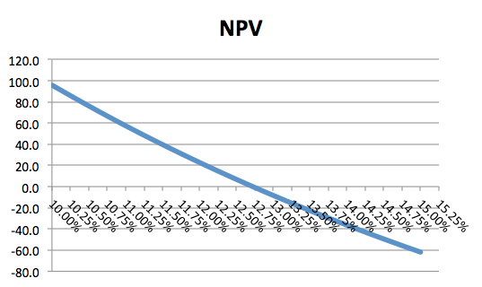
At 12% cost of capital the NPV is $22.8 million. From the graph, the IRR appears to be 12.75% (you can check that the NPV is zero under this IRR)
The NPV will remain positive as long as the cost of capital is below the IRR

Slide 43
IRR for Non-Standard Stream of CFs
Question 17 (2nd edition)
Your firm has been hired to develop new software for the university’s class registration system. Under the contract, you will receive $500,000 as an upfront payment. You expect the development costs to be $450,000 per year for the next three years. Once the new system is in place, you will receive a final payment of $900,000 from the university four years from now.
What are the IRRs of this opportunity?
If your cost of capital is 10%, is the opportunity attractive?
Now suppose that you are able to renegotiate the terms of the contract so that your final payment in year 4 will be $1million.
What is the IRR of the opportunity now?
Is it attractive at these terms?

Slide 44
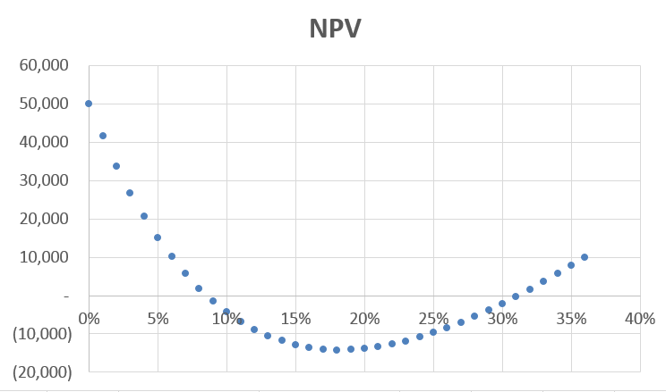
IRR for Non-Standard Stream of CFs
There are two IRR’s in this example. The NPV is positive for sufficiently high or sufficiently low rates.

Slide 45
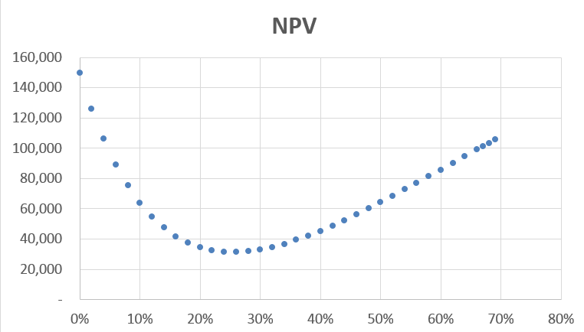
IRR for Non-Standard Stream of CFs
Now that the terminal payment is $1 million, even a high interest rate does not imply a negative NPV. Actually, the NPV is always positive.

Slide 46
Profitability Index for Natasha’s Flowers
Question 29 (2nd edition)
Natasha’s Flowers, a local florist, purchases fresh flowers each day at the local flower market. The buyer has a budget of $1000 per day to spend. Different flowers have different profit margins, and also a maximum amount the shop can sell. Based on past experience, the shop has estimated the following NPV of purchasing each type.
What combination of flowers should the shop purchase each day?
 | NPV per bunch | Cost per bunch | Max. bunches
Roses | $3 | $20 | 25
Lilies | 8 | 30 | 10
Pansies | 4 | 30 | 10
Orchids | 20 | 80 | 5

Slide 47
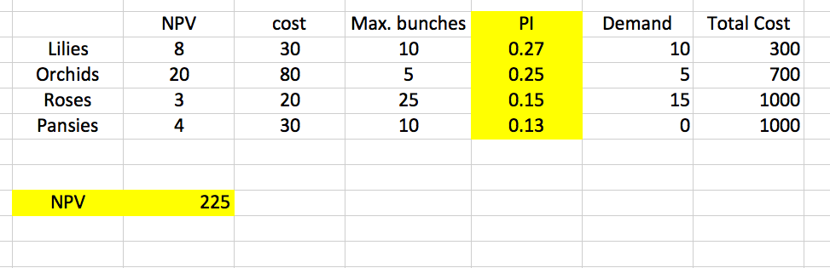
Profitability Index for Natasha’s Flowers
Given the constraint of $1000 to spend we rank the flowers by “NPV per dollar cost.” For example, per bunch the Orchids yield $20 NPV and cost $80 or a PI of 0.25. Lilies have a higher PI at 0.27.
The buyer should start with the Lilies, then the Orchids, and with the remaining funds purchase Roses.

Slide 48
Appendix
For those that are interested
EVA with Depreciation

Slide 49
Applying the EVA Rule with Depreciation
You are considering installing energy efficient lighting in your firm's warehouse. The installation will cost $300,000, and you estimate total savings of $75,000 per year. The lights will depreciate evenly over the 5 years, at which point they must be replaced. The cost of capital is 7%, per year. What do the NPV and EVA rules indicate about whether you should install the lights?

Slide 50
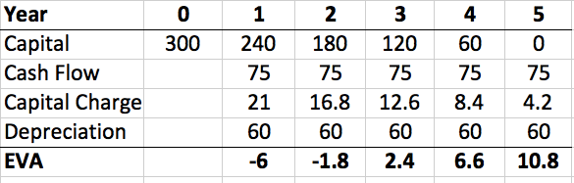
Applying the EVA Rule with Depreciation

